Slide 1
MACHINE LEARNING INTRODUCTION
BY
Dr. S PADMANABHAN

Slide 2
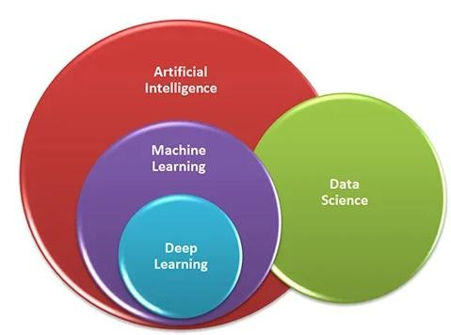
What is MACHINE LEARNING?
Machine learning is the branch of Artificial Intelligence (AI) that focuses on the development of algorithms and models that enable computers to learn patterns from data and make predictions or decisions without being explicitly programmed.
In essence, machine learning allows systems to improve their performance on a specific task over time as they are exposed to more data.

Slide 3
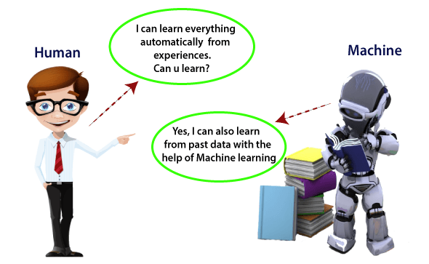
In simple words, ML teaches the systems to think and understand like humans by learning from the data.

Slide 4
Why is MACHINE LEARNING?
Machine learning is essential because it empowers organizations to leverage data effectively, automate processes, make informed decisions, and create personalized experiences. Its ability to handle complex tasks, predict future outcomes, and adapt to new information makes it a vital tool across various industries, including healthcare, finance, marketing, and more. As data continues to grow in volume and complexity, the importance of machine learning will only increase, making it a crucial technology for the future.

Slide 5
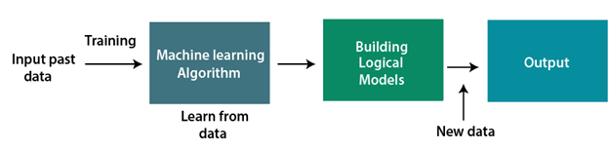
How does Machine Learning work?
Machine learning is an iterative process that involves training models using data, evaluating and tuning them to ensure accuracy, and deploying them to make predictions or automate decisions. The cycle continues as new data is integrated, ensuring the model stays relevant and accurate.

Slide 6
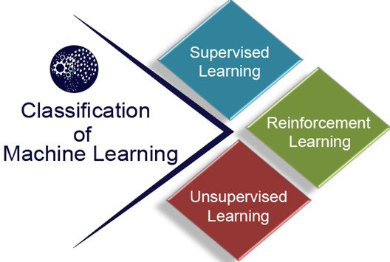
Classification of Machine Learning

Slide 7
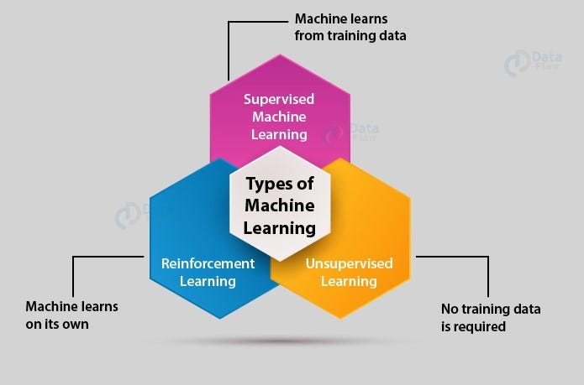

Slide 8
What is Supervised Machine Learning?
Supervised Machine Learning is a type of machine learning where the model is trained on a labeled dataset to make predictions or decisions based on the data inputs. The goal of supervised learning is for the model to learn a mapping from inputs to outputs so that it can predict the output of new, unseen data.
A labelled dataset is one that has both input and output parameters.

Slide 9
Key Concepts of Supervised Machine Learning
Training Data: The model is provided with a dataset that includes input-output pairs. The inputs are known as features, and the outputs are known as labels or targets. This labeled data is used to train the model.
Learning Process: During training, the model makes predictions based on the input data. These predictions are compared to the actual labels, and the model adjusts its parameters to minimize the difference between its predictions and the actual outcomes. This process is typically done using optimization techniques like gradient descent.

Slide 10
Key Concepts of Supervised Machine Learning
Generalization: The goal of supervised learning is to create a model that generalizes well to new data, meaning it performs accurately on data that it hasn't seen before. This ability to generalize is crucial for the model's applicability in real-world scenarios.

Slide 11
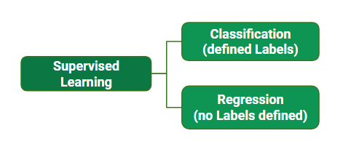
Types of Supervised Learning Algorithm
Supervised learning is typically divided into two main categories: Regression and Classification.

Slide 12
In regression, the algorithm learns to predict a continuous output value, such as the price of a house or the temperature of a city.
In classification, the algorithm learns to predict a categorical output variable or class label, such as whether a customer is likely to purchase a product or not.

Slide 13
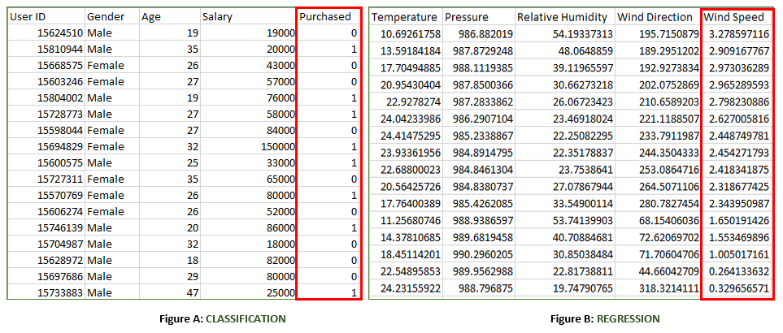

Slide 14
What is Unsupervised Machine Learning?
Unsupervised Machine Learning is a type of machine learning where the model is trained on a dataset without labeled responses. Unlike supervised learning, where the output is known and provided for training, unsupervised learning works with input data that lacks explicit outputs. The goal is to uncover hidden patterns, structures, or relationships within the data without any prior knowledge of what to expect.

Slide 15
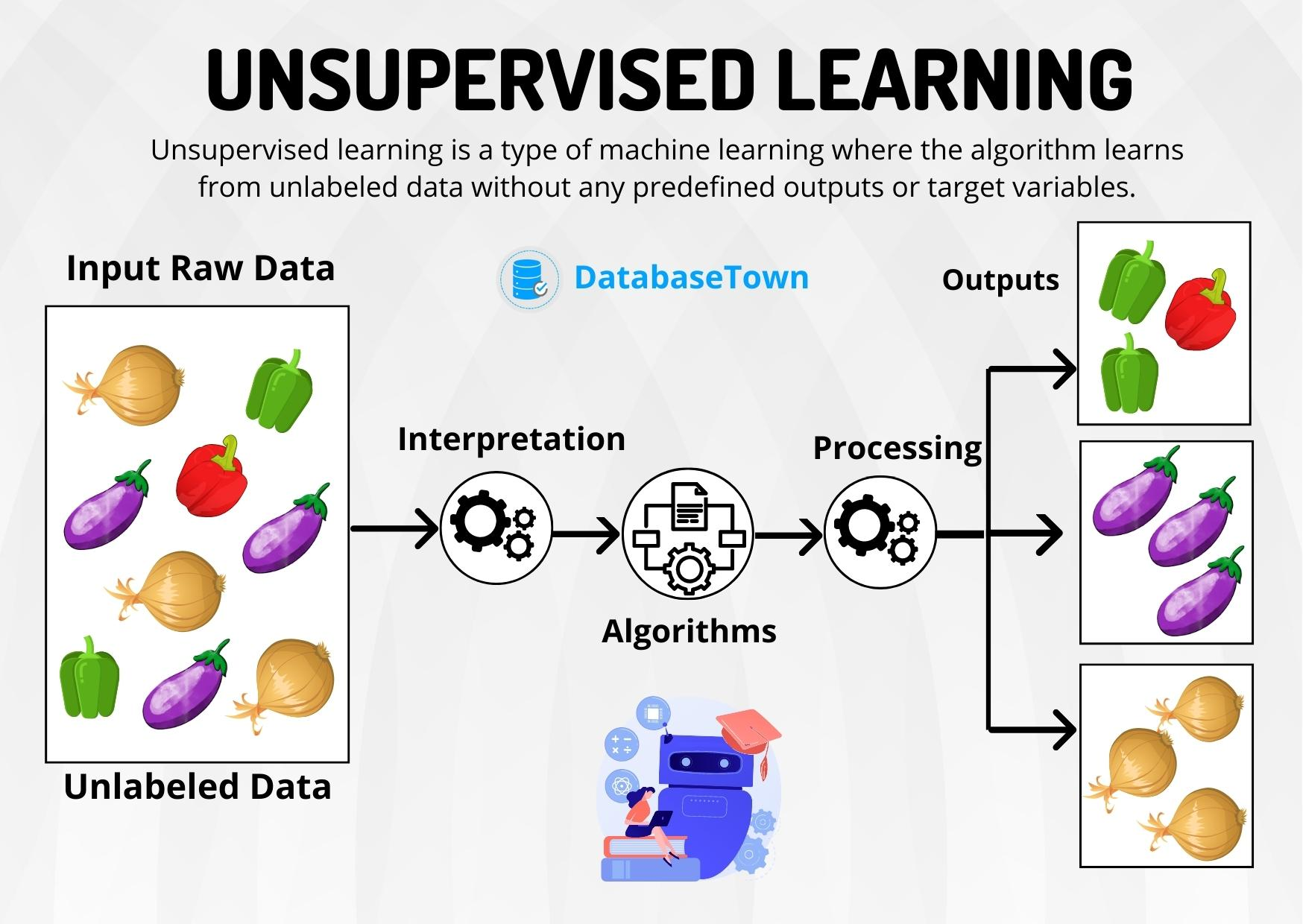

Slide 16
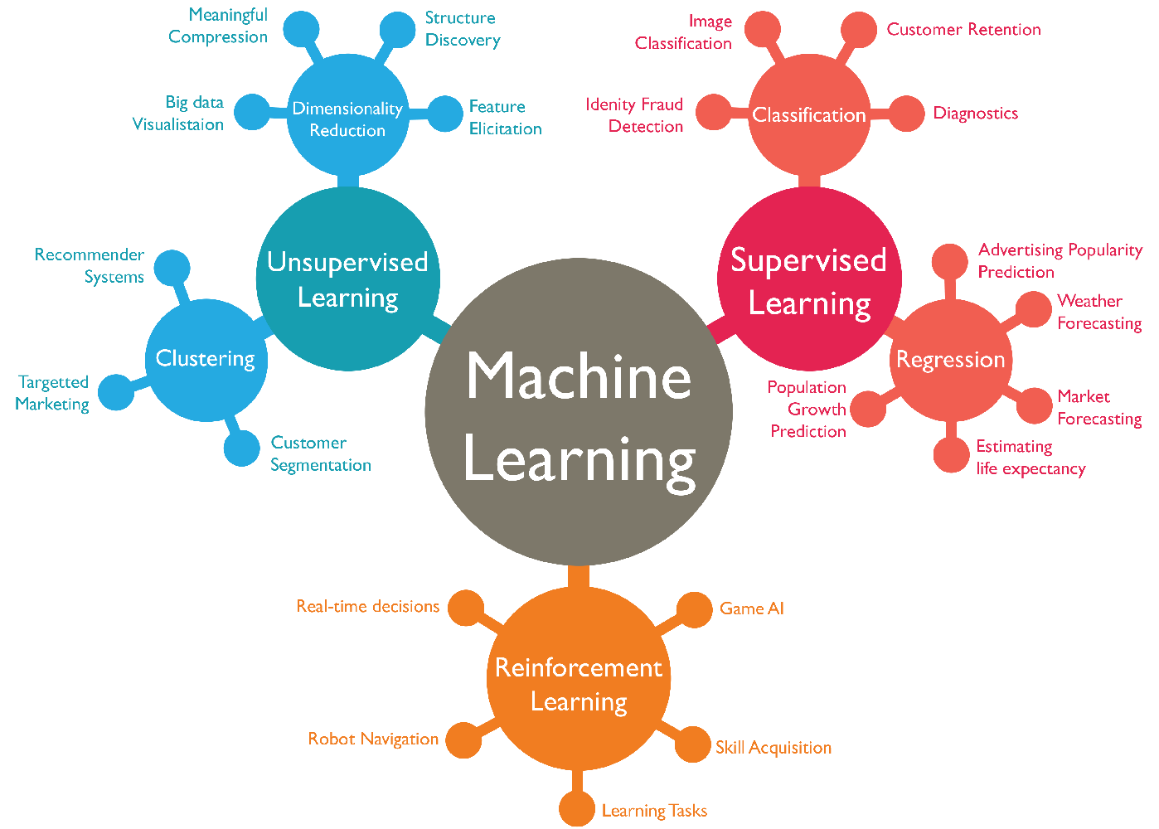

Slide 17
1. Supervised Learning Algorithms
A. Regression
Linear Regression
Ridge Regression
Lasso Regression
Support Vector Regression (SVR)
Decision Trees Regression
Random Forest Regression
Gradient Boosting Regression
Neural Networks Regression

Slide 18
1. Supervised Learning Algorithms
B. Classification
Logistic Regression
Support Vector Machines (SVM)
k-Nearest Neighbors (k-NN)
Naive Bayes
Decision Trees
Random Forest
Gradient Boosting (e.g., XGBoost, LightGBM, CatBoost)
Neural Networks (e.g., Multilayer Perceptron)

Slide 19
2. Unsupervised Learning
A. Clustering
k-Means
Hierarchical Clustering
DBSCAN (Density-Based Spatial Clustering of Applications with Noise)
Gaussian Mixture Models (GMM)

Slide 20
2. Unsupervised Learning
B. Dimensionality Reduction
Principal Component Analysis (PCA)
t-Distributed Stochastic Neighbor Embedding (t-SNE)
Linear Discriminant Analysis (LDA)
Independent Component Analysis (ICA)
UMAP (Uniform Manifold Approximation and Projection)
C. Association
Apriori Algorithm
Eclat Algorithm

Slide 21
3. Reinforcement Learning
A. Model-Free Methods
Q-Learning
Deep Q-Network (DQN)
SARSA (State-Action-Reward-State-Action)
Policy Gradient Methods (e.g., REINFORCE)
B. Model-Based Methods
Deep Deterministic Policy Gradient (DDPG)
Proximal Policy Optimization (PPO)
Trust Region Policy Optimization (TRPO)
C. Value-Based Methods
Monte Carlo Methods
Temporal Difference (TD) Learning

Slide 22
4. Ensemble Learning
Bagging (e.g., Random Forest)
Boosting (e.g., AdaBoost, Gradient Boosting)
Stacking

Slide 23
1. Logistic Regression
Description: Logistic regression models the probability of a binary outcome using a logistic function. It outputs probabilities and classifies instances by setting a threshold (usually 0.5).
Key Points:
Simple and easy to implement.
Assumes linear relationship between the input features and the log-odds of the outcome.
Works well for binary classification problems.
Applications: Email spam detection, disease diagnosis, credit scoring.

Slide 24
2. Support Vector Machines (SVM)
Description: SVMs find the hyperplane that best separates different classes by maximizing the margin between them.
Key Points:
Effective in high-dimensional spaces.
Works well for both linear and non-linear classification using kernel trick.
Sensitive to the choice of kernel and regularization parameter.
Applications: Image classification, text categorization, bioinformatics.

Slide 25
3. k-Nearest Neighbors (k-NN)
Description: k-NN classifies instances based on the majority class among the k-nearest neighbors in the feature space.
Key Points:
Simple and intuitive.
No explicit training phase, making it a lazy learner.
Sensitive to the choice of k and the distance metric.
Applications: Recommender systems, pattern recognition, anomaly detection.

Slide 26
4. Naive Bayes
Description: Naive Bayes uses Bayes’ theorem with the assumption of feature independence to classify instances.
Key Points:
Fast and efficient.
Performs well with high-dimensional data.
Assumption of feature independence might not hold in all cases.
Applications: Text classification, sentiment analysis, spam filtering.

Slide 27
5. Decision Trees
Description: Decision trees split data into subsets based on the value of input features, creating a tree-like model of decisions.
Key Points:
Easy to interpret and visualize.
Can handle both numerical and categorical data.
Prone to overfitting without proper pruning.
Applications: Risk assessment, fraud detection, customer segmentation.

Slide 28
6. Random Forest
Description: Random forest is an ensemble of decision trees that improves accuracy and controls overfitting by averaging multiple trees trained on different subsets of data.
Key Points:
Reduces overfitting compared to individual decision trees.
Handles large datasets with higher dimensionality.
Requires more computational resources.
Applications: Financial forecasting, image classification, healthcare diagnostics.

Slide 29
7. Gradient Boosting (e.g., XGBoost, LightGBM, CatBoost)
Description: Gradient boosting builds models sequentially to correct errors made by previous models, optimizing for accuracy.
Key Points:
Highly accurate and efficient.
Can handle different types of data.
Prone to overfitting if not properly tuned.
Applications: Web search ranking, customer churn prediction, insurance risk prediction.

Slide 30
8. Neural Networks (e.g., Multilayer Perceptron)
Description: Neural networks use layers of interconnected nodes to model complex patterns in data.
Key Points:
Capable of learning non-linear relationships.
Requires large amounts of data and computational power.
Can be prone to overfitting.
Applications: Image recognition, speech recognition, natural language processing.

Slide 31
9. k-Means
Description: k-Means partitions data into k clusters based on feature similarity, minimizing the sum of squared distances from each point to the centroid of its assigned cluster.
Key Points:
Simple and efficient.
Sensitive to the initial placement of centroids.
Assumes clusters are spherical.
Applications: Customer segmentation, market research, image compression.

Slide 32
10. Hierarchical Clustering
Description: Hierarchical clustering builds a hierarchy of clusters using either a bottom-up (agglomerative) or top-down (divisive) approach.
Key Points:
Does not require a predefined number of clusters.
Produces a dendrogram for visualizing the hierarchy.
Computationally intensive for large datasets.
Applications: Social network analysis, gene sequence analysis, document clustering.

Slide 33
11. DBSCAN (Density-Based Spatial Clustering of Applications with Noise)
Description: DBSCAN groups together points that are close to each other based on distance and density, and identifies outliers as points that lie alone in low-density regions.
Key Points:
Can find arbitrarily shaped clusters.
Robust to noise and outliers.
Requires tuning of the density parameters.
Applications: Geographic data analysis, fraud detection, biology.

Slide 34
12. Principal Component Analysis (PCA)
Description: PCA reduces the dimensionality of data by transforming it to a new set of orthogonal features (principal components) that capture the maximum variance.
Key Points:
Reduces complexity of data.
Helps in visualizing high-dimensional data.
Assumes linear relationships among features.
Applications: Data compression, noise reduction, feature extraction.

Slide 35
13. t-Distributed Stochastic Neighbor Embedding (t-SNE)
Description: t-SNE reduces dimensions for visualization by preserving the local structure of the data, making similar points stay close together.
Key Points:
Effective for visualizing high-dimensional data.
Computationally intensive.
Does not preserve global structure well.
Applications: Visualizing clusters, exploring high-dimensional data, anomaly detection.

Slide 36
14. Linear Discriminant Analysis (LDA)
Description: LDA reduces dimensions by maximizing class separability, transforming data to a space that best discriminates between classes.
Key Points:
Maximizes class separability.
Assumes normally distributed classes with identical covariances.
Useful for supervised dimensionality reduction.
Applications: Pattern recognition, face recognition, bioinformatics.

Slide 37
15. Apriori Algorithm
Description: The Apriori algorithm identifies frequent itemsets in transactional data and generates association rules.
Key Points:
Simple and easy to implement.
Can handle large datasets.
Computationally expensive for large itemsets.
Applications: Market basket analysis, cross-selling strategies, web usage mining.

Slide 38
16. Eclat Algorithm
Description: The Eclat algorithm uses depth-first search to find frequent itemsets, improving efficiency by reducing the number of database scans.
Key Points:
More efficient than Apriori for large datasets.
Uses vertical data format.
Requires sufficient memory for large itemsets.
Applications: Market basket analysis, bioinformatics, text mining.

